Slide 1
Design Tips

Slide 2
Three Storage Engines
Row Store
8KB data pages
All data in memory
Column-Store
Vertical
InMemory OLTP
Logs can be written to disk
Page locks
Lock free
Partitioned
Compressed
10x - 30X txn perf increase
10x – 20x smaller & faster

Slide 3
In-Memory OLTP (“Hekaton”)
Lock-free, latch-free fast super-fast relational tables
10x performance increase is easy, 30x is achievable
Few limitations in SQL Server 2016
Please note the “In-Memory” part
Same TSQL syntax to insert, update, delete, …
Natively compiled stored procedures
Optionally persisted to disk
Fast transactions
Near real-time reporting
Session state
Poker hands ☺
Write intensive logging
Transaction logging

Slide 4

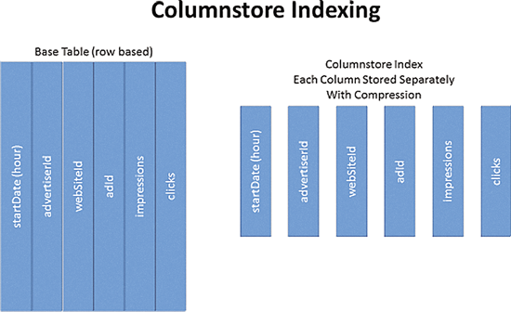

Slide 5
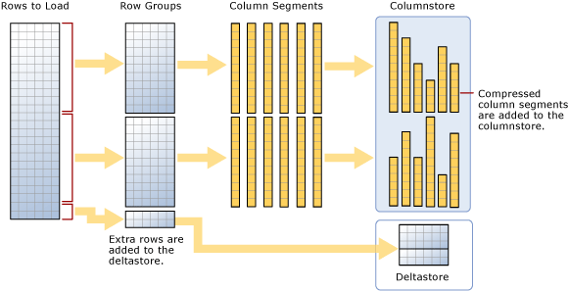

Slide 6
Column-Store
Partitioned, vertical storage
10X to 20X compression
Very fast range scans
Very good at wide fact tables
Can sit on row-store or OLTP tables (real-time analytics)
Good candidates are…
Wide – lots of columns
Mostly read-only
Tall – lots of rows
More scanning and summing
Less seeking individual rows
Demo!

Slide 7
Read Committed Snapshot Isolation
Writers block Writers.
Readers don’t take read locks.
Requires different coding practices
Generates additional I/O to keep Version Store in tempdb
Can be enabled for existing workloads but best to start from scratch
Consider Snapshot Isolation for existing workloads
Very nice to avoid NOLOCK everywhere
Demo!

Slide 8
Real-Time Analytics
Enable RCSI
Build non-clustered column store indexes on your transaction tables
RCSI prevents blocking
Run your reporting out of an AG replica
Near-real-time analytics:
Capture changes from CDC or Change Tracking
In-Memory OLTP structure with column-store on top
SQL Server Replication to a table with column-store indexes

Slide 9
Storage
Enable page compression on tables and indexes with repeating values
20% - 60% reduction in storage space
Can be done with an index rebuild (online in Enterprise)
Available on Standard Edition after SQL Server 2016 SP1
Consider column-store indexes across all columns
May prevent the need for some indexes

Slide 10
SQL Server Permissions
Server Logins
Get you into the server: Windows groups, SQL Server logins, etc.
Database Users
Map to logins using a SID
Get you permissions inside the database
Server Roles
sysadmin, bulkadmin, dbcreator, securityadmin
Database Roles
db_owner, db_datareader, db_datawriter, custom role for EXEC
Database, Schema & Object Permissions
EXEC, SELECT, INSERT, …

Slide 11
Special Roles and Users
Server: public role
Everyone is in this – can grant permissions
Database: guest user
Disabled by default
Any login without a user is “guest”
Allows any login in the database
Allow INSERTs to audit database?
Allow INSERTs to logging database?
Database: public role
Every database user is in this

Slide 12
Security
People go into groups
Optionally a group for like people (CSRs, Developers, etc.)
Then a group for permissions (Read-Only, Deploy, SysAdmin, Txn Admin)
Services are granted permissions directly (or one group per service)
Domain\SvcTxnHost
Use schemas to group permissions
Never, ever enable xp_cmdshell
CREATE SCHEMA [rpt]
GRANT EXEC ON schema::[rpt] TO [app_ReadOnlyRole]
CREATE PROC rpt.TxnReport

Slide 13
My Default Security Groups for People
Separate login for changes
Sysadmin
Deployment – for schema changes
ddl_admin, db_datawriter, db_securityadmin
Avoid db_owner if you can
Read-Only
db_datareader, view definition, showplan
Possibly EXEC on some stored procedures or schemas
Start with server-wide default groups
Have a standard script that creates and grants these groups to all databases on a server
Kendra Little’s “Automation: Granting Read Perms for Devs”

Slide 14
SQL like it’s NoSQL
Adding column with NOT NULL DEFAULT is a meta data change
Changing data types is easier in SQL Server 2016
Increase INT to BIGINT
Enable ROW compression, then expand
Store schema-less data in XML or key-value tables
JSON in SQL Server 2016
Availability Groups and Replication support adding and removing columns
Avoid SELECT * as this may break when columns change

Slide 15
Non-Relational Data
Maybe create a Entity Attribute Value table?
EntityID, Attribute, Value
Maybe sql_variant to store different data types?
COMPRESS!
Store XML in an XML data type
Store JSON in NVARCHAR (SQL Server 2016)
Can build indexes on parsed JSON values
Demo!

Slide 16
Object Naming
Table Names are SINGULAR! Everyone else is WRONG!
Match your class in the client application
Sort better in lists
Intersection tables are “UserAccount” instead of “UsersAccounts”
I hate your ActivitiesDetail table
JOINS are Customer.AccountID = Account.ID
Person. People? Persons?
I like MixedCase instead of broken_words
I like ObjectAction but I’m more flexible here (or Object_Action)
BE CONSISTENT

Slide 17
Primary Keys
Every non-key [column] must provide a fact about the key, the whole key, and nothing but the key
1NF – the key exists & no repeating columns (customer1, customer2) or repeating values
2NF – columns depend on the whole key
3NF – columns depend on nothing but the key
Natural vs. Surrogate keys
OrderNumber & OrderLineNumber vs. OrderLineID
Maybe more difficult in an ORM world
Eliminates unneeded or redundant data
You can always add an IDENTITY with an index
May need a little defragmenting now and then
De-normalize for performance

Slide 18
Data Types
Use BIGINT for single column primary keys for large tables
Loggins, auditing, etc.
Especially for tables that grow
Use DATETIMEOFFSET to capture time zone information
Remember DATE and TIME
Consider UNICODE vs. ASCII
Demo!

Slide 19
Table Features
Referential integrity
Check constraints
Defaults
Login, current time, identity, sequence, @@SPID
Unique constraints
NULLs
Compression
Computed columns
Demo!

Slide 20
Views
Think of a view as an API into your database
It’s just a reusable query
Active customers
Complicated joins
Filters where you can assign permissions
Can replace a table
Rename the table
Create a view with the original table name
Add triggers to view to update the renamed table (or a new table)

Slide 21
Deploying Schema Changes
Hand-rolled
Visual Studio SQL Server Database Tools (SSDT)
Put your database schema under source control
Third-Party Tools
Very good schema compare
Embed change scripts in the application
Don’t forget permissions
Don’t forget data
DB2 Demo!

Slide 22
Other Schema Change Tools
Entity Framework Migrations – From Microsoft
Red Gate
Fluent Migrator
RoundhousE
DbUp

Slide 23
Questions?

